Slide 1
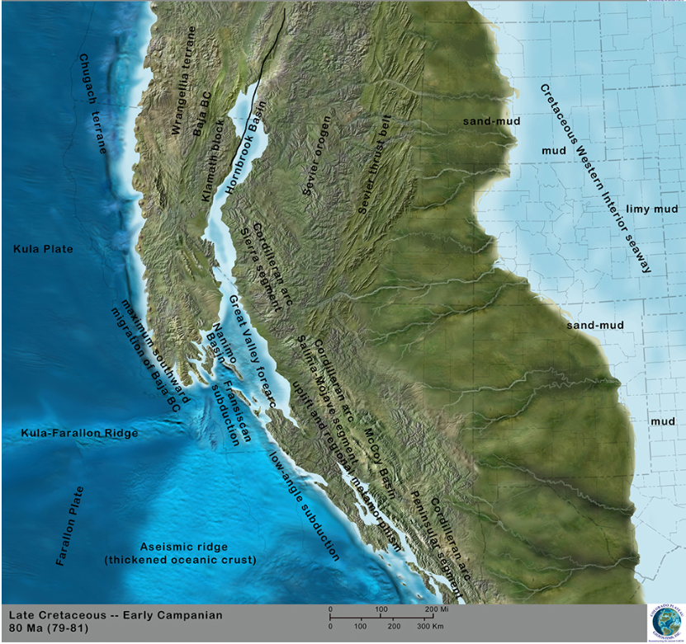
Correlation of plate motions with continental tectonics: Laramide to basin-Range
Engebretson 1984
Geol 730 Presentation By: Neal Mankins
Colorado Plateau Geosystems

Slide 2
Purpose
Questions
To examine a current tectonic model focusing on the northern Basin & range province & northern Laramide thrust region
“Determine whether plate motions along a particular latitude can be correlated with tectonic & magmatic events more than 1000km into the continental interior”
1. Why did “Flat Slab Subduction” begin?
2. What brought about the abrupt change from Laramide compression to extension accompanied by a flare-up of magmatic activity?
Method
Using a model developed in previous paper (Engebretson, 1982)

Slide 3
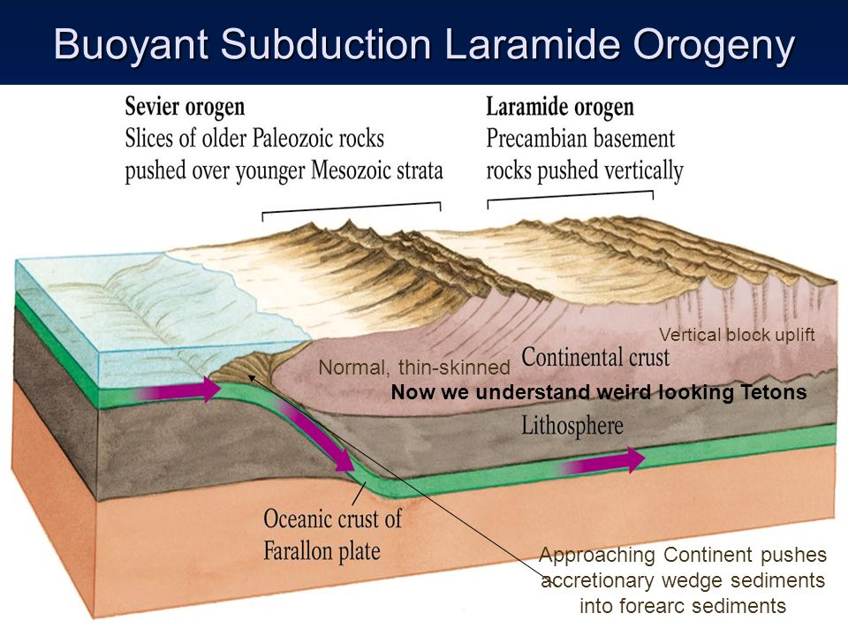
Background
Regional Tectonics
Emplacement of the Sierra Nevada batholith ceased ~80Ma
Increased rate of Farallon-North America (NA) convergence (pre-Laramide)
Laramide compressional deformation ~80-53Ma
Decreased rate of Farallon-North America (NA) convergence (post Laramide)
Nestanet.org

Slide 4
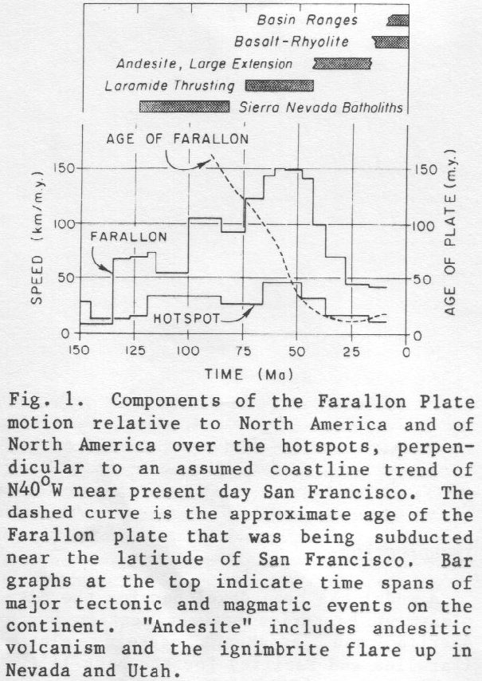
Motion of Farallon plate relative to hotspots
(upper curve)
Motion of NA plate relative to hotspots
(lower curve)

Slide 5
Assumptions
1. Assuming hot spots of the Atlantic region have remained fixed relative to hotspots of the Pacific
2. Assumed west coastline trend of N40W
3. Assuming consistent thicknesses and ages of oceanic plate parallel to spreading ridge

Slide 6
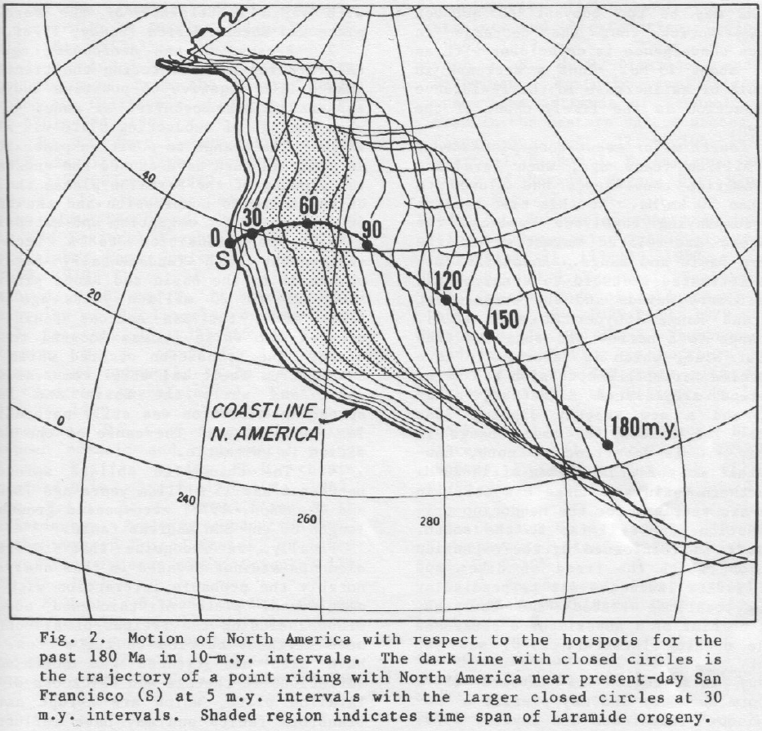
North America Motion
Shading = Laramide Compression
San Fransisco Point Track
Point track near modern day San Fransisco in the hotspot refrence frame (fixed)
Coastline of North America shown at intervals of 10 million years
Note: Speed up of the plate near start of the Laramide (widely spaced lines) and slowdown near the end (closely spaced lines)

Slide 7
Interpretation 1
Why did “Flat Slab Subduction” begin?
Increased movement of the NA plate toward and over subducted plate
Rapid convergence of Farallon plate toward NA (pre Laramide)
Slowing convergence of the Farallon and North America plates are due to the decreasing age of the Farallon plate entering the trench which changes the state of the subducting slab from negative to positive buoyancy (post Laramide)

Slide 8
Interpretation 11
What brought about the abrupt change from Laramide compression to extension accompanied by a flare-up of magmatic activity?
Combined slowdown of Farallon-NA convergence with simultaneous slowdown of the NA plate over the hotspot
Possibly with slower convergence and lower compressive stress magmas can rise more easily through the crust
Subducting Farallon plate grew younger & (Molnar & Gray, 1979) found that a plate younger than 50-30Ma may be too buoyant to subduct easily

Slide 9
Findings
Flat Slab Subduction
Decreasing age of the Farallon Plate changed state from negative to positive buoyancy which slowed plate convergence and ended Laramide compression
Back Arc Magmatism
Stagnant flat slab
“Transtion to a back-arc environment is enigmatic”
Narrow Arc Transition “Western Andesites”
Flat slab stagnated and a new steeply dipping slab formed
“Reason for this change is obscure”
No mention of slab rollback or slab window

